Slide 1
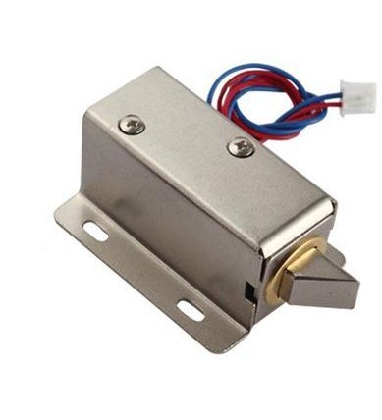
Solenoid

Slide 2
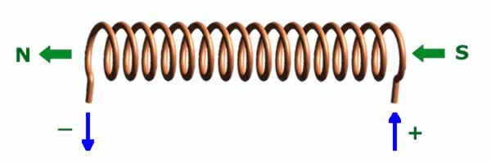
A Solenoid is a coil of wire, When current runs through that Coil of wire, creates a electromagnet. A solenoid is a type of electromagnet when the purpose is to generate a controlled magnetic field.
An electromagnetic actuator that converts an electrical signal into a magnetic field producing a linear motion is called the Linear Solenoid.

Slide 3
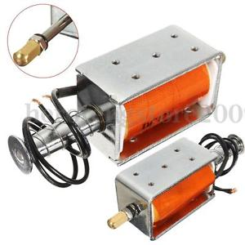
Linear solenoid’s basically consist of an electrical coil wound around a cylindrical tube with a ferro-magnetic actuator or “plunger” that is free to move or slide “IN” and “OUT” of the coils body. Solenoids can be used to electrically open doors and latches, open or close valves, move and operate robotic limbs and mechanisms, and even actuate electrical switches just by energising its coil.

Slide 4
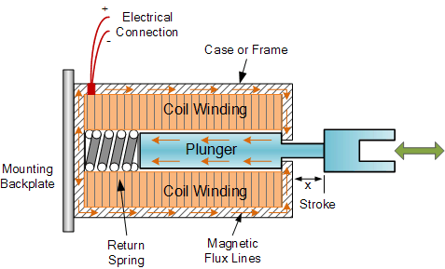
This type of solenoid is generally called a Linear Solenoid due to the linear directional movement and action of the plunger. Linear solenoids are available in two basic configurations called a “Pull-type” as it pulls the connected load towards itself when energised, and the “Push-type” that act in the opposite direction pushing it away from itself when energised. Both push and pull types are generally constructed the same with the difference being in the location of the return spring and design of the plunger.

Slide 5
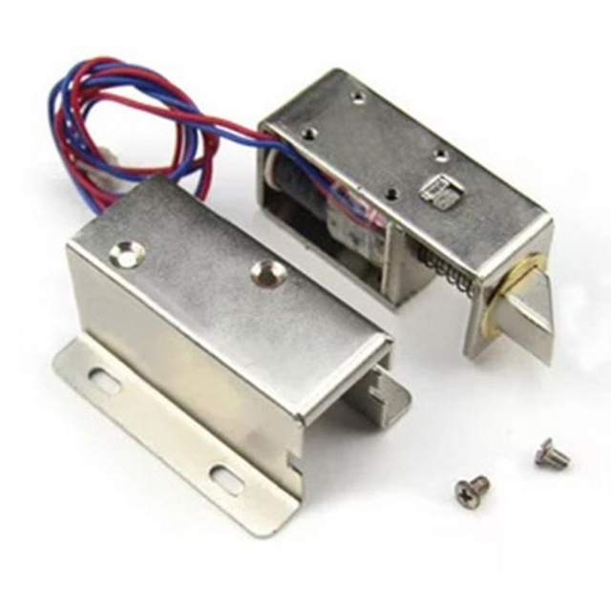
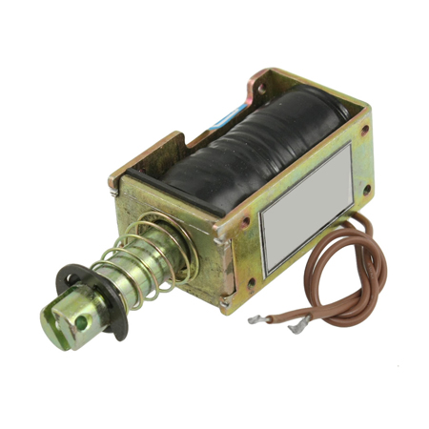

Slide 6
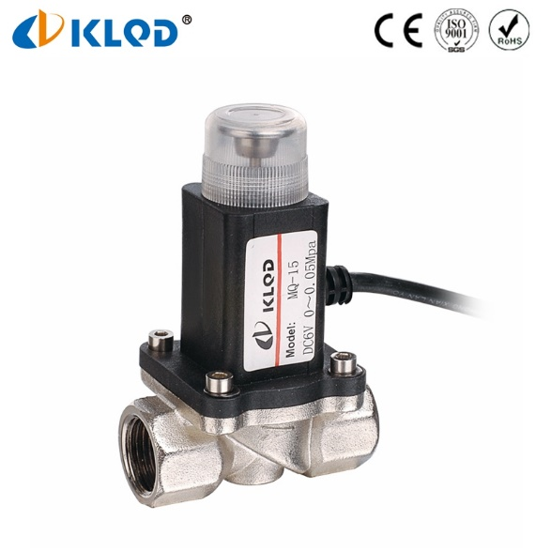
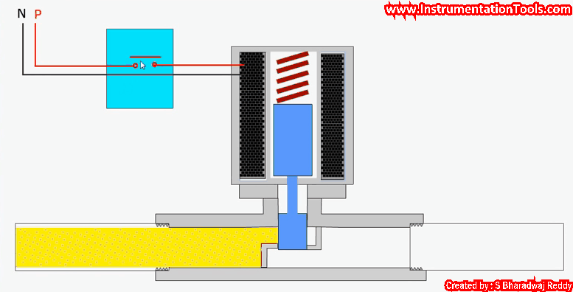

Slide 7
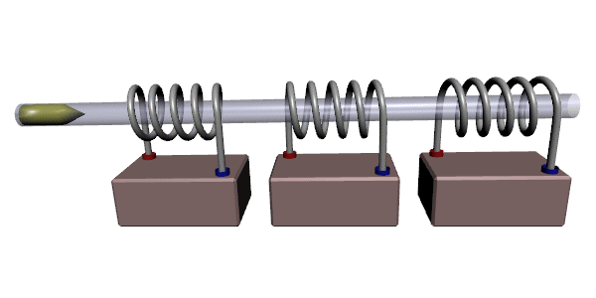
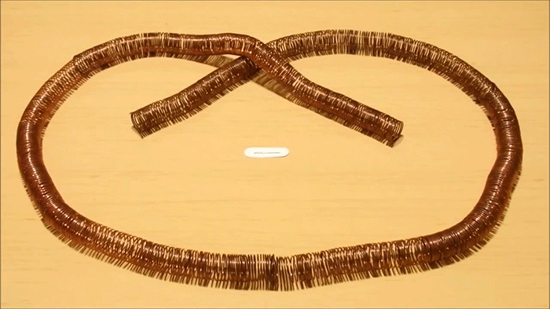

Slide 8
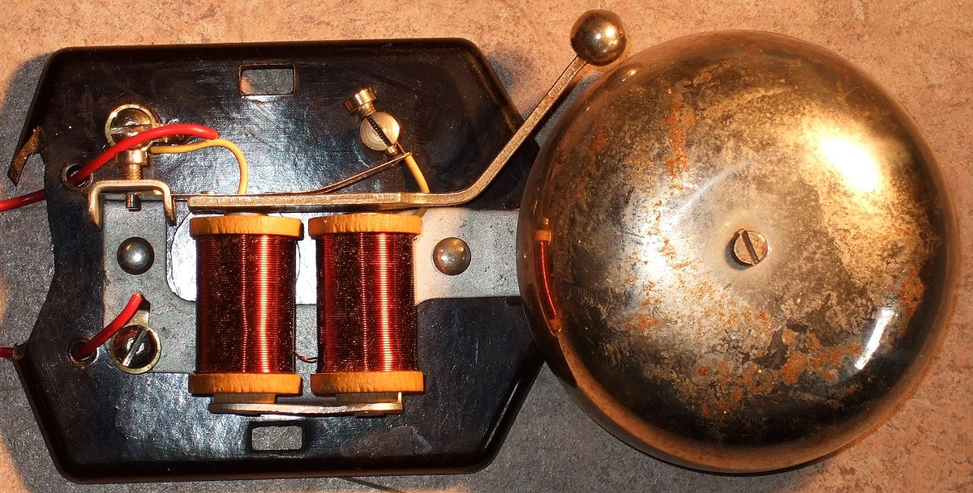

Slide 9
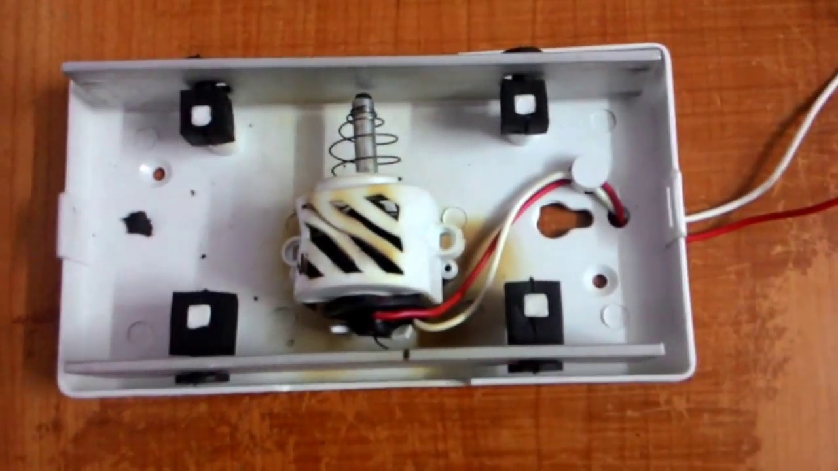

Slide 10
Electromagnetic Relay
A relay is an electromagnetic switch used to switch High Voltage or Current using low power circuits. For example, we can use it for controlling home appliances with a normal low voltage electronic circuit. Electromagnetic relays uses an electromagnet to operate a switching mechanism mechanically. It also provides isolation between low power circuit and high power circuits.

Slide 11
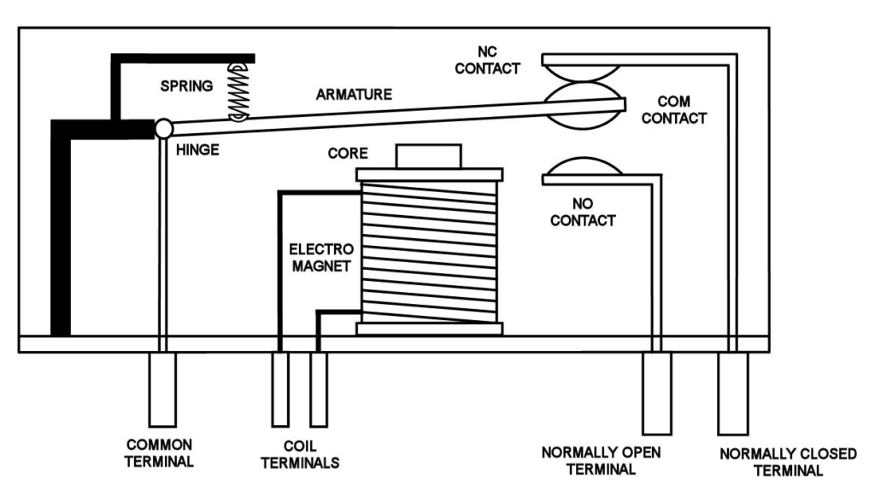
The construction & working of relay can be understood from the diagram. The main part of the relay is electromagnet. The electromagnet is made by a coil of wire wrapped around a soft iron core.
Normally a SPDT relay has 5 terminals. Two them are used to energies the electromagnet & other three are COM, NO, NC. COM stands for Common, NO stands for Normally Open & NC stands for Normally Closed. When the electromagnet is not energized, the armature will be connected to NC contact. Thus COM & NC will be connected. When the electromagnet is energized the electromagnet attracts the iron armature & it will be connected to NO contact. Thus COM & NO will be connected.

Slide 12
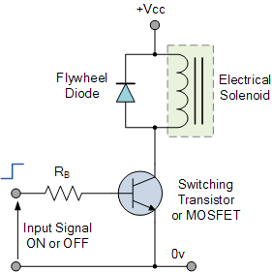

Slide 13
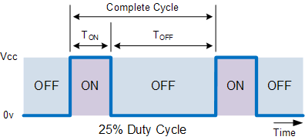

Slide 14
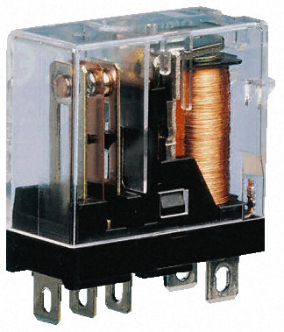

Slide 15
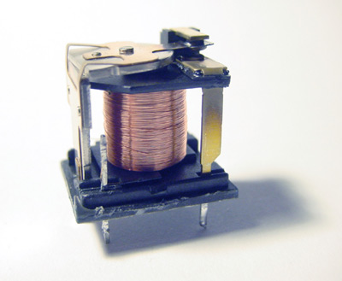
Inside of A Relay

Slide 16
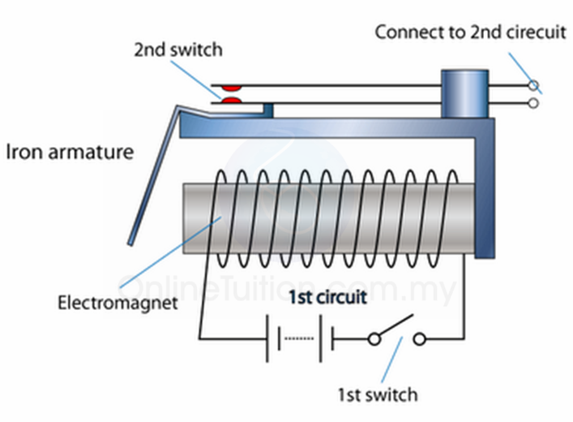

Slide 17
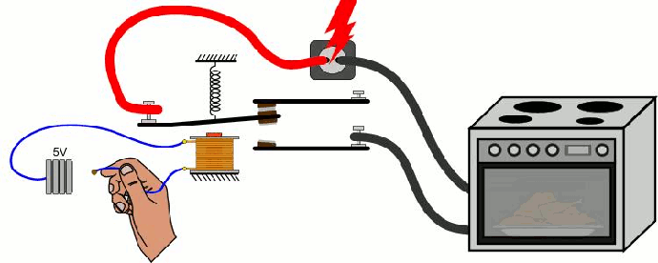

Slide 18
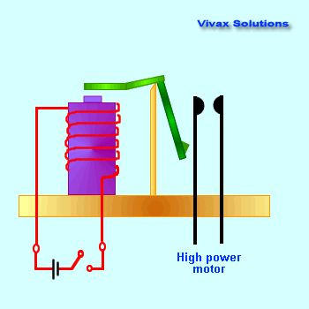
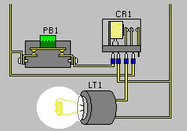

Slide 19
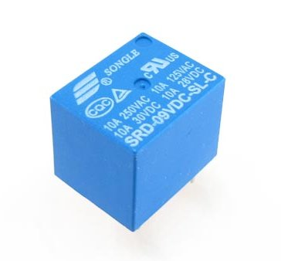
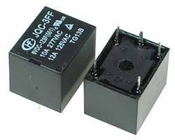
How are they look like

Slide 20
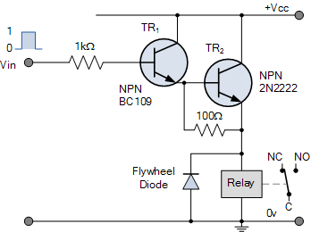
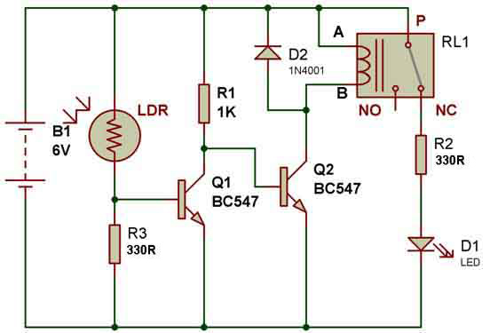
Application Circuit

